Slide 1

GROUP II
HACKATHON
PROJECT
(Finding Hospitals)
QEA20QE007

Slide 2

Leader:
Nidhi Kumari(873295)
Group
Members:
Nidhi Kumari(873295)
Abhilasha(873098)
Kunal Sandilya(873291)
Sayantani Majee(873299)
Shagufta Parween(873405)

Slide 3
Problem Statement
1. For Bangalore city, identify Hospitals that is Open 24/7, has Parking facility with rating more than 3.5; Display the hospital names
2. In Diagnostics page, pick all the top cities name & store in a List; Display the same
3. Go to Corporate Wellness, fill invalid details, schedule & capture the warning message from the alert
Website Used : https://www.practo.com/

Slide 4
WORK DONE
The code is written in JAVA language and automated using Selenium
Page Object Model(POM) is used to reduce code duplication
TestNG is used to segregate smoke and regression tests
Data obtained from Websites is stored in Excel sheet using Apache POI
HTML report is generated using Extent Report

Slide 5
Functions Tested:
• Found Hospital Names and rating which has Parking facility. Open 24x7 and rating 3.5 above and stored in Excel sheet
• Stored Top Cities names from Diagnostics page in Excel sheet
• Captured Alert Message generated after giving invalid details in Corporate Wellness page
Fields Tested:
• Has Parking
• Open 24X7
• Name
• Organization Name
• Official Email ID
• Contact Number
• Search Location
• Search Box

Slide 6
Script Description
• Maven generates two folders by default
Main
Test
Packages in main folder are:
tests
This package contains the main requirement test which has given in problem statement
ii. POM_pages
This package contains different page classes under Page object Model
iii. Utility
This contains classes to setup driver, manage Extent report and to take Screen Shot
SmokeAndRegression
This package contains classes to test smoke and regression functionalities
DataDriven
This package contains classes to read or write to excel
Configuration
This package impliments the object repository

Slide 7
Problem Faced
Sl no. | Issues Faced | Solution
1 2 3 | There are some hospitals which does not have rating. Because of the above issue, expected no.of result was not displaying. If one tries to book appointment at evening for the same day the timeslot shows the message"no slots available". | Wrote our own code to filter ratings used Dynamic Xpath and list concept which can get hospital names which has rating. Used JavaScript Executor window scroll to get the desired result. Wrote an xpath for the timeslot "tomorrow" instead of "today".

Slide 8
Tech. We used
Java: Programing Language
Eclipse IDE: Integrated Development Environment
Selenium: Portable Framework for testing Web Application
TestNG: Open source testing Framework
Maven: Software and Project management Tool
Apache POI: JAVA Library for reading and writing in Microsoft Formats
POM: Object Repository Design Pattern
Extent Report: Used to generate HTML report
Git Bash
Jenkins

Slide 9
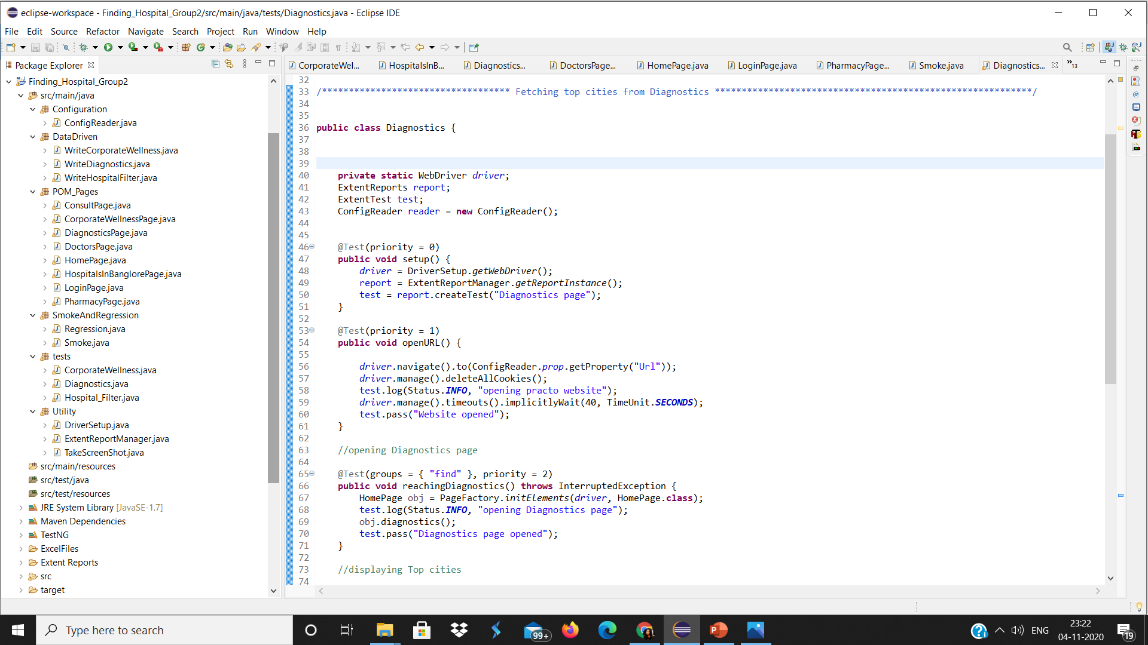
PROJECT FILE STRUCTURE

Slide 10
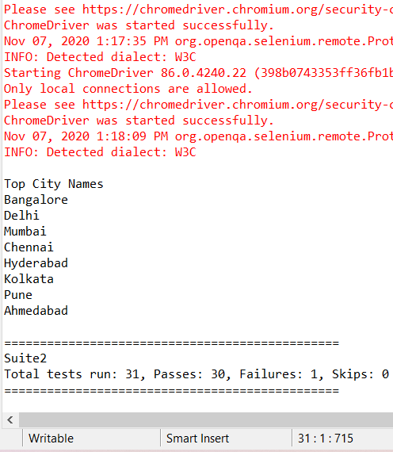
OUTPUT
Test Case executed: 34
Test Case Passed: 33
Test Case Failed: 1

Slide 11
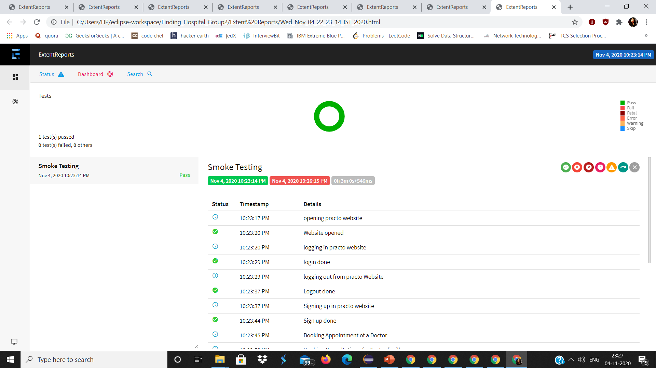
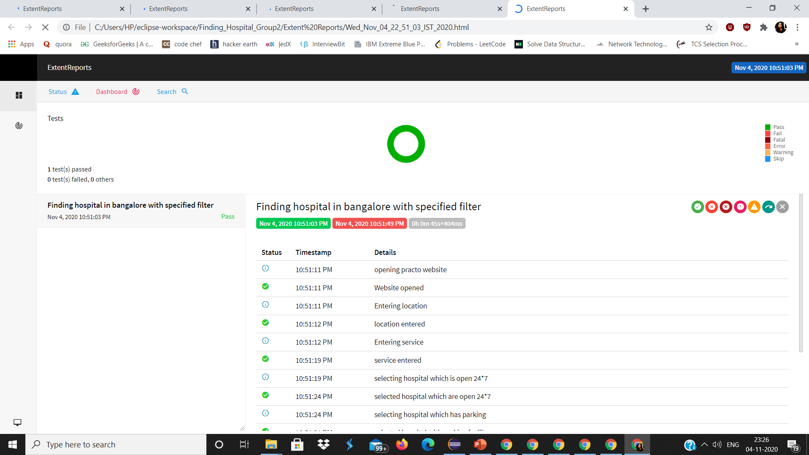
EXTENT REPORT

Slide 12
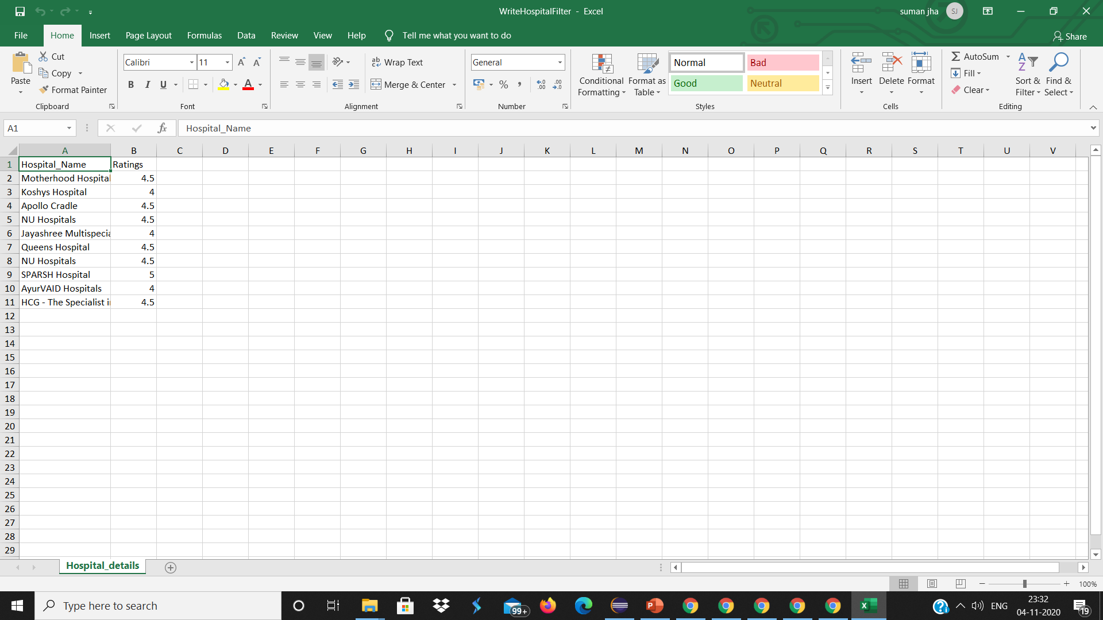

EXCEL DATA

Slide 13
Thank you
Group II

